Slide 1

JOB SEARCH PORTAL APP
PRESENTED BY
SABA FARHEEN – 160320737004
SUMIYA AMREEN – 160320737005
NAYELA QUDSIYA – 160320737008
GUIDED BY : SAMEENA SIDDIQUi

Slide 2
TABLE OF CONTENT
INTRODUCTION
LITRATURE SURVEY
EXISTING SYSTEM
PROPOSED SYSTEM
ARCHITECTURE
SYSTEM REQUIREMENT
TECHNOLOGY USED
UML DAIGRAM
APPLICATION
FEATURES
ADVANTAGES
FUTURE ENHANCEMENT
CONCLUSION
OUTPUT

Slide 3

INTRODUCTION
Job Search: Empowering Your Career Journey! Our cutting-edge mobile application developed using React Native seamlessly connects job seekers with their dream opportunities on both iOS and Android platforms, With user friendly interfaces and advanced algorithms Catalyst
Job Search offers personalized job recommendations real-time notifications and interactive features to streamline your job search process, Explore endless possibilities discover tailored job listings and embark on your career adventure with confidence, Your dream job is just a tap awayl.

Slide 4

LITRATURE SURVEY
The first official launch of job board sites took place in 1992 when Bill Warren introduced ‘Online Career Center.’
Initially, it was a BBS or a Bulletin Board, which eventually merged with Monster in 1995.
In its initial years, job boards had a generalist approach.
Recruiters could find employees from across the world and vice versa.
While newspapers had a limited reach and geographical constraints, job board websites could reach out to innumerable people at one go.

Slide 5

EXISTING SYSTEM
The job seeker need to verify/ keep track of employment related magazines for current openings in several organizations. And the job providers must publish ads in magazines, which is a cost effective activity.
Even for appearing in primary selection, the job seekers need to go the organization, which is a time taking process.
The organization need to facilitate huge crowd for selecting people, even for preliminary selection, which includes lot of man power

Slide 6





The Problem
Declining Market
Financial
Trust
Cost
Margins

Slide 7

PROPOSED SYSTEM
The proposed job portal system aims to create a dynamic platform facilitating seamless interaction between job seekers and recruiters.
With an intuitive user interface, job seekers can efficiently search for opportunities
The system prioritizes personalized experiences, incorporating features such as an application tracking system and advanced search functionalities.

Slide 8


Solution
Prioritize
Authorize
TIME SAVING

Slide 9
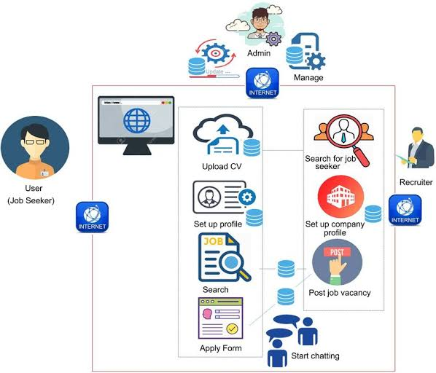
ARCHITECTURE

Slide 10
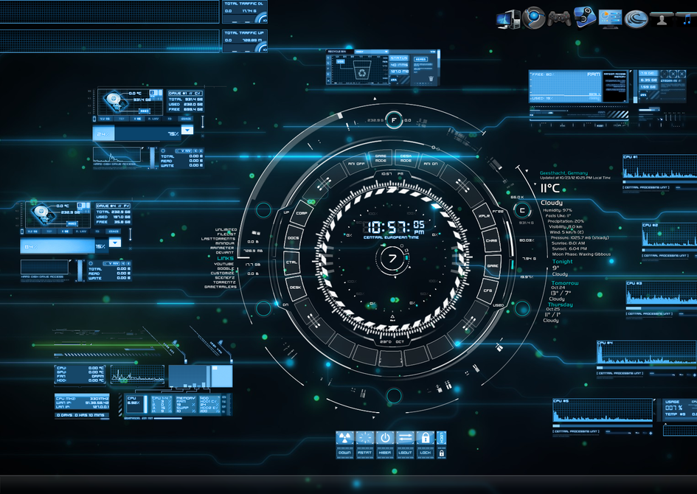
System requirement

Slide 11





Hardware Requirements
System
Hard Disk
monitor
Input devices
Ram
Pentium dual core
120 GB
15" LED
Keyboard ,mouse
1GB

Slide 12



Software Requirements
Operating System
Database
Tools
Windows 10
Android studio and its tools
Firebase

Slide 13



Technology Used
Language
Front end
Backend
Java script
Expo react native native wind
Firebase
13

Slide 14
UML DAIGRAMS

Slide 15
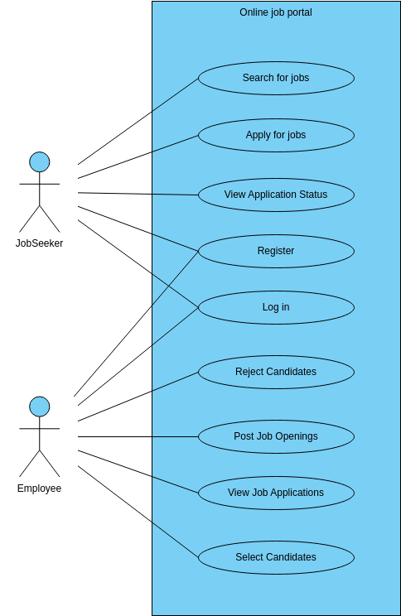
USE CASE

Slide 16
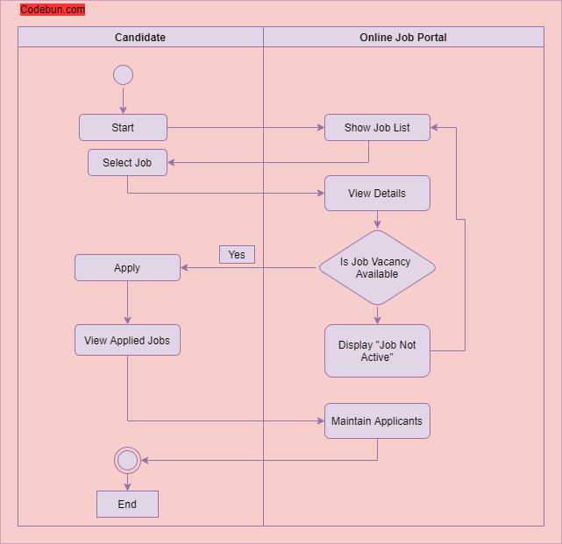
ACTIVITY DAIGRAM

Slide 17
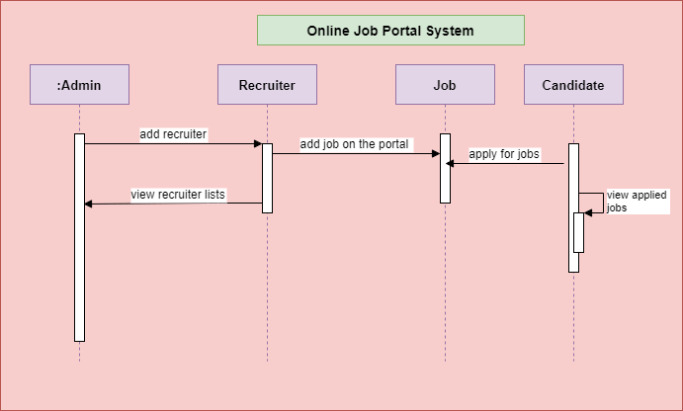
SEQUENCE DAIGRAM

Slide 18
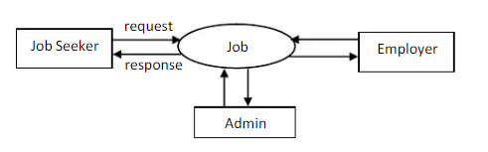
DATA FLOW DAIGRAM
LEVEL 0

Slide 19
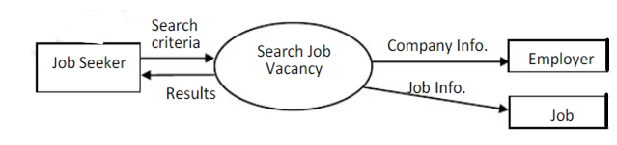
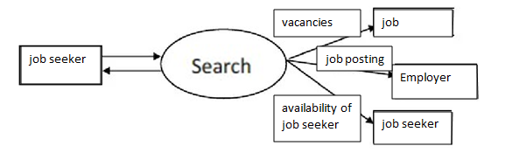
LEVEL 1
LEVEL 2

Slide 20
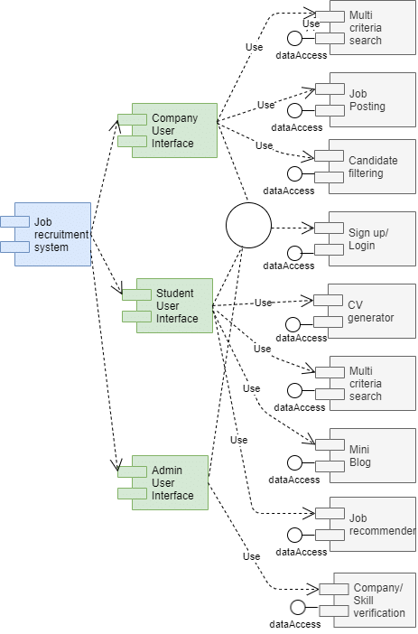
COMPONENT DAIGRAM

Slide 21
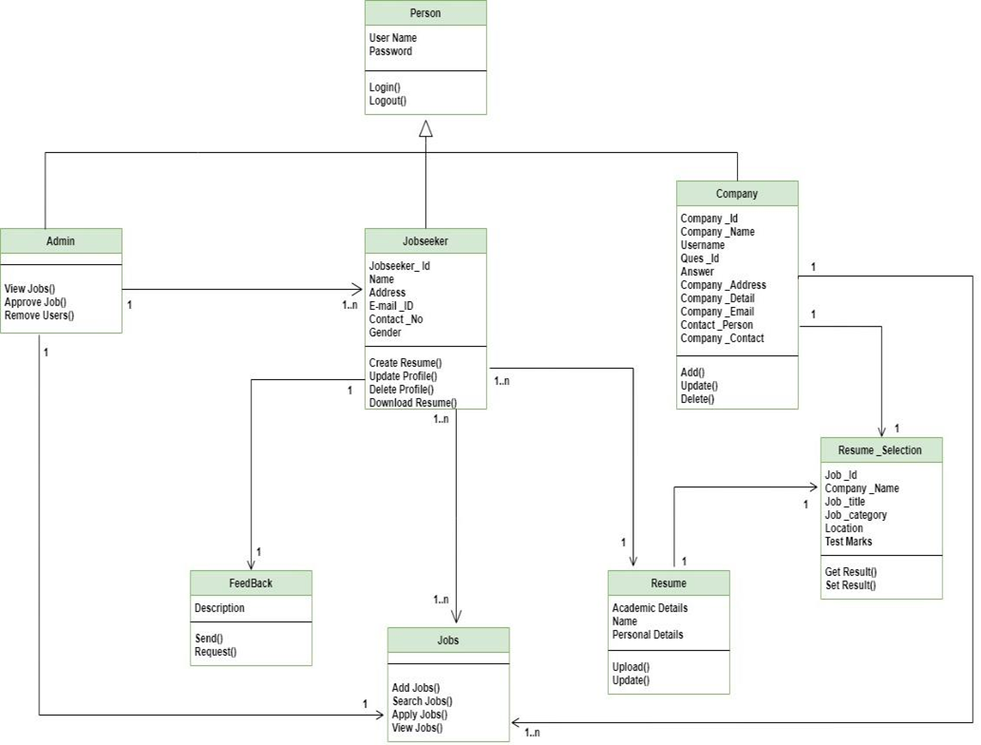
CLASS DAIGRAM

Slide 22
output

Slide 23
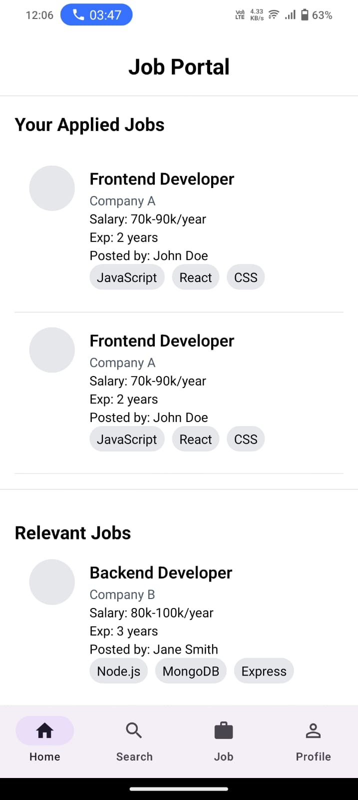
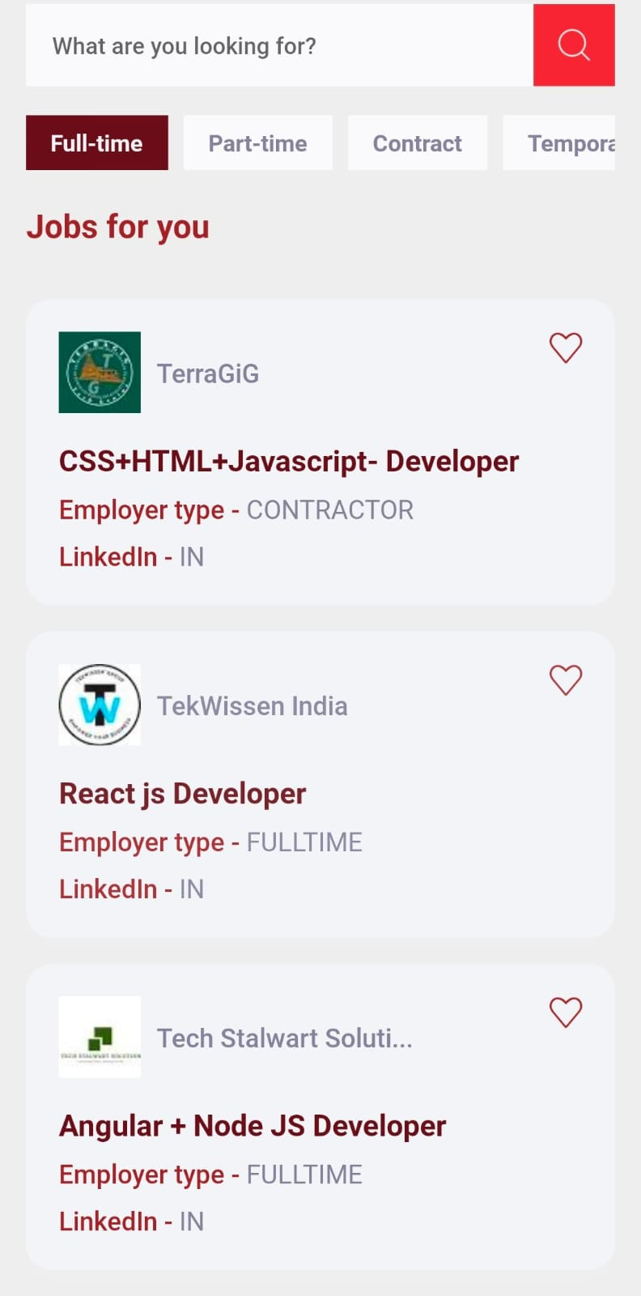

Slide 24
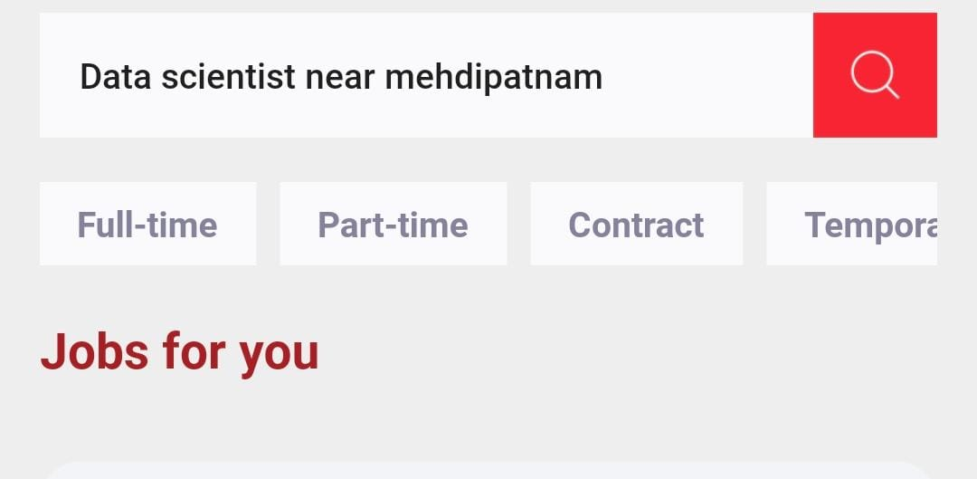

Slide 25
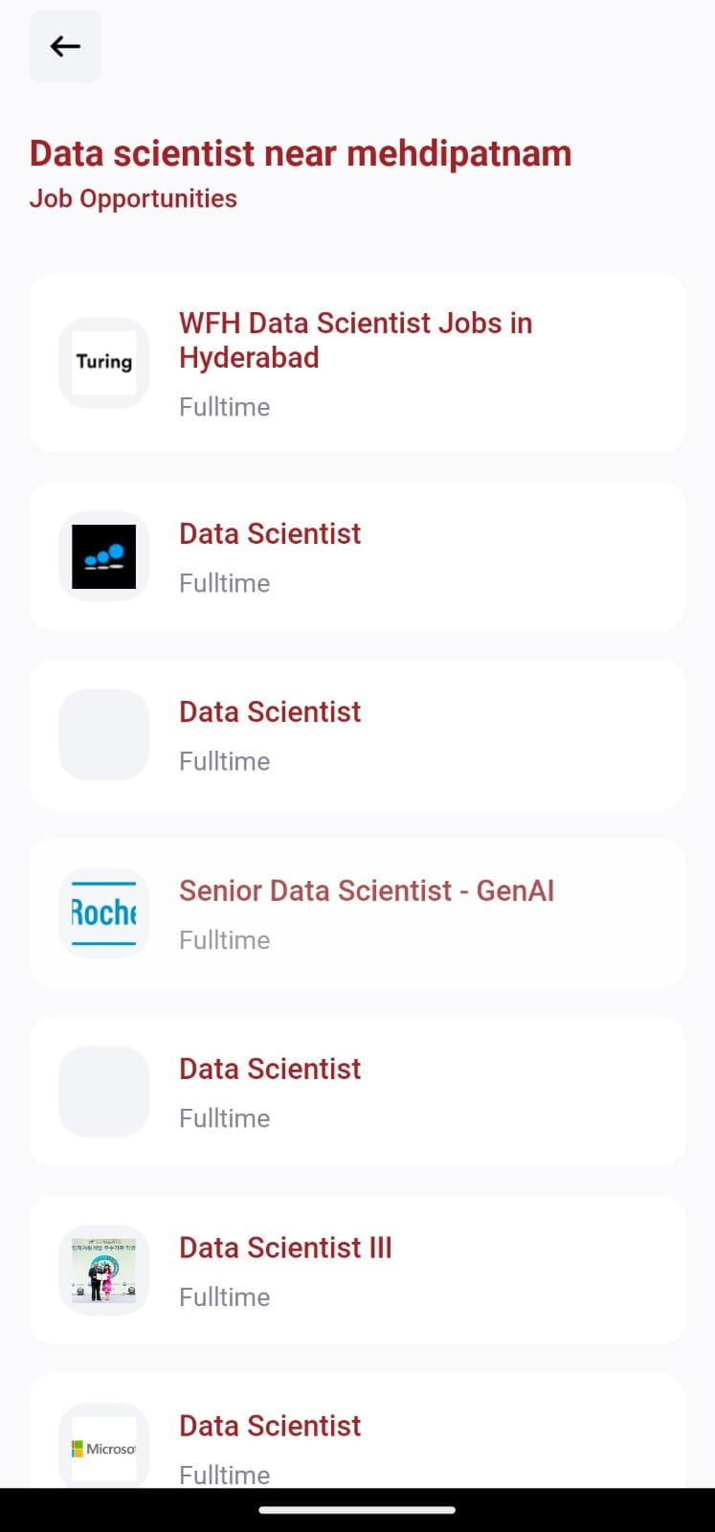
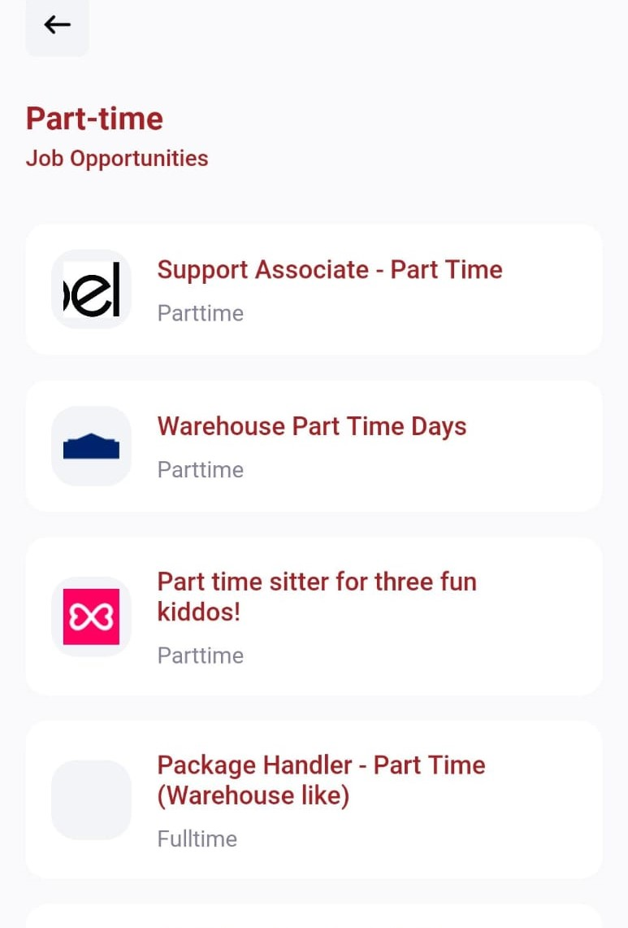

Slide 26
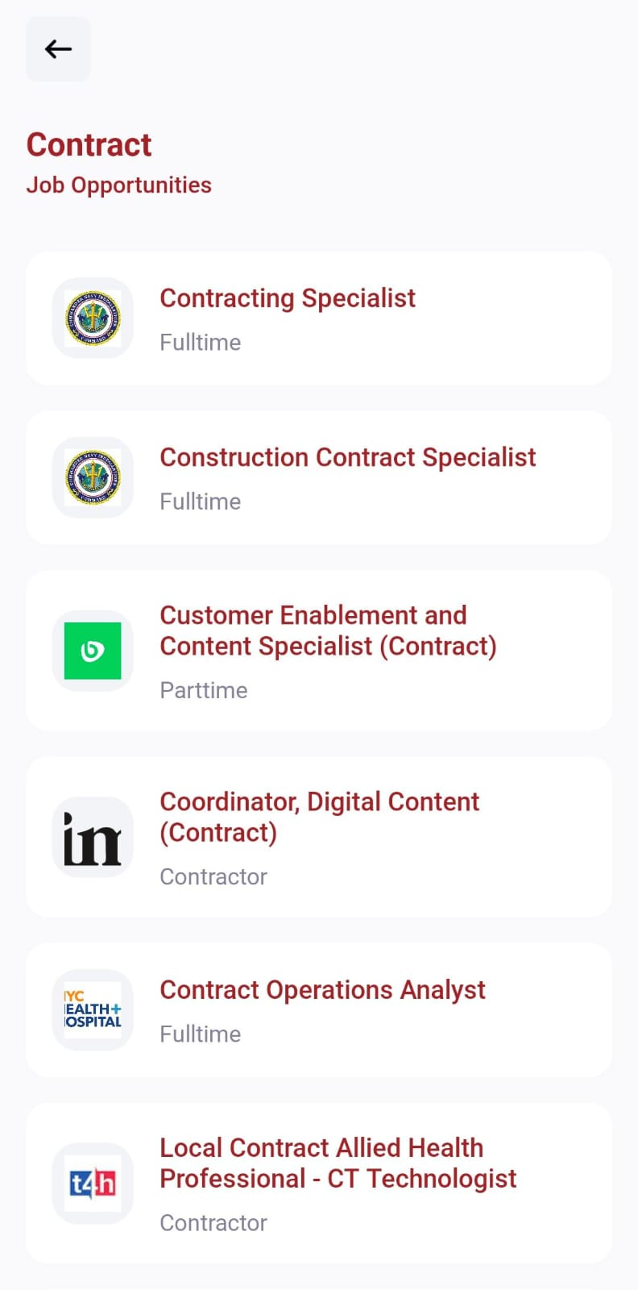
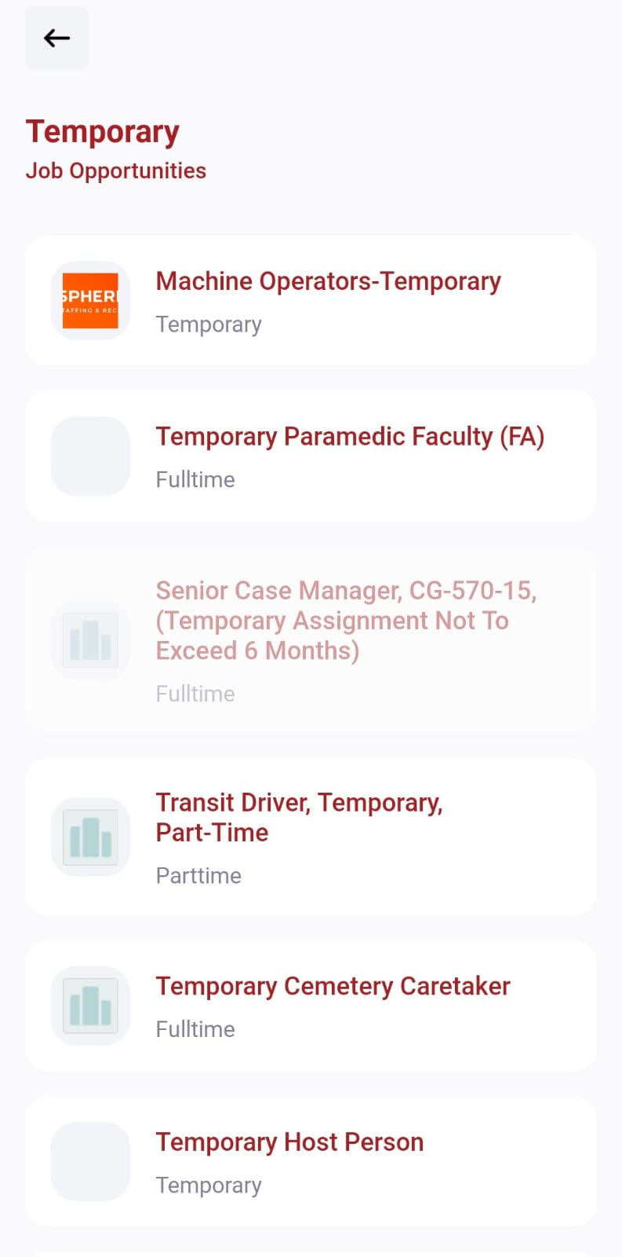

Slide 27
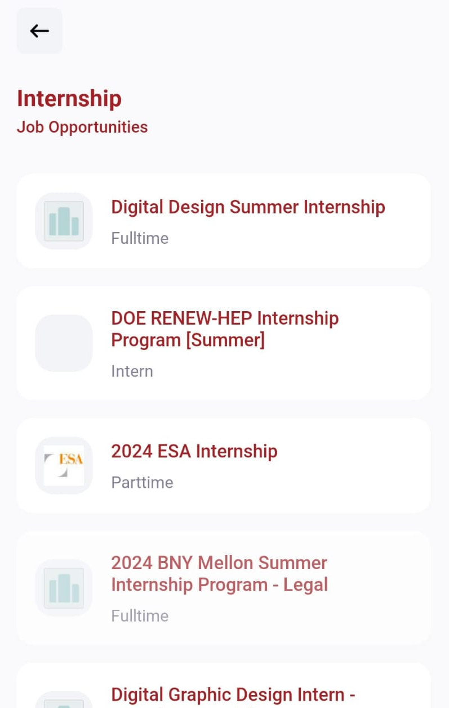
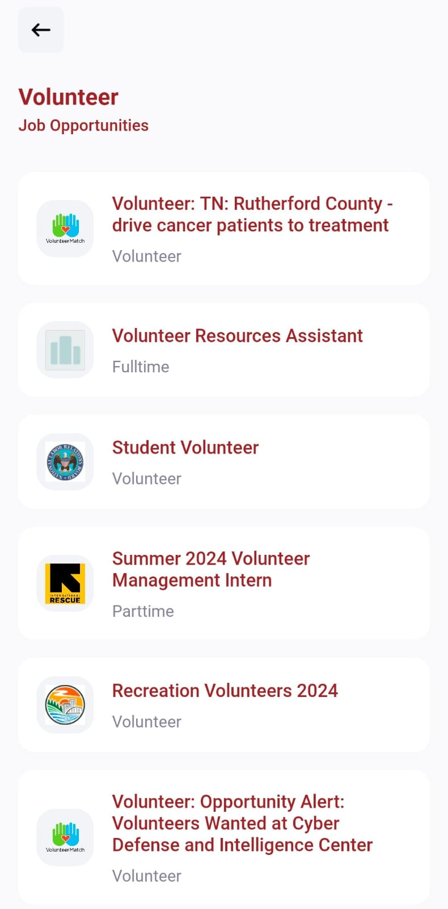

Slide 28
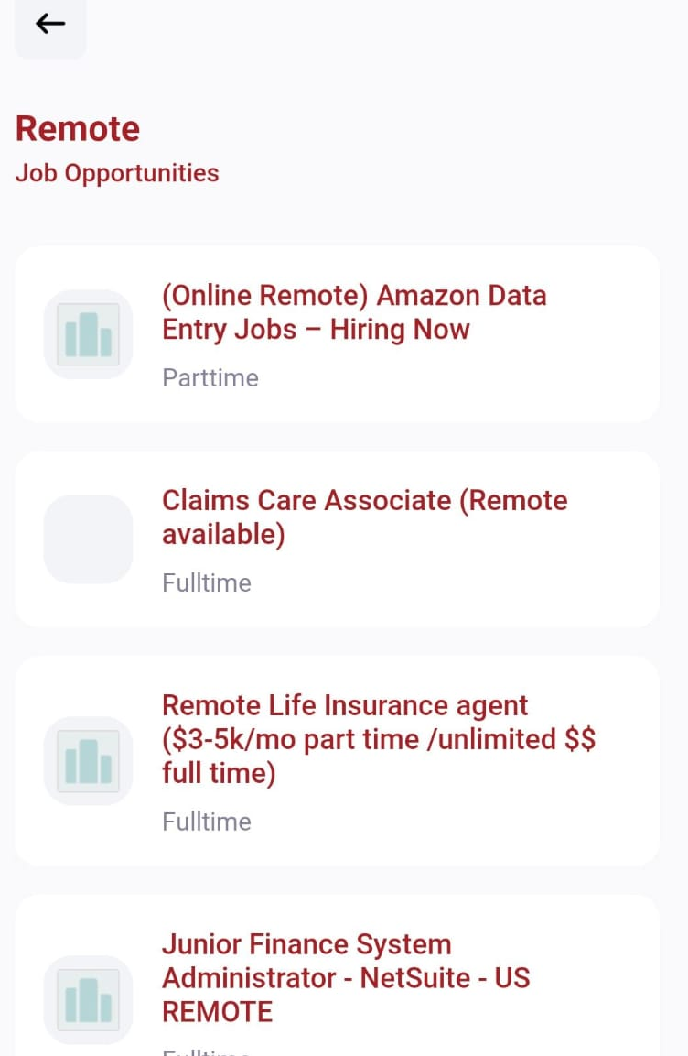
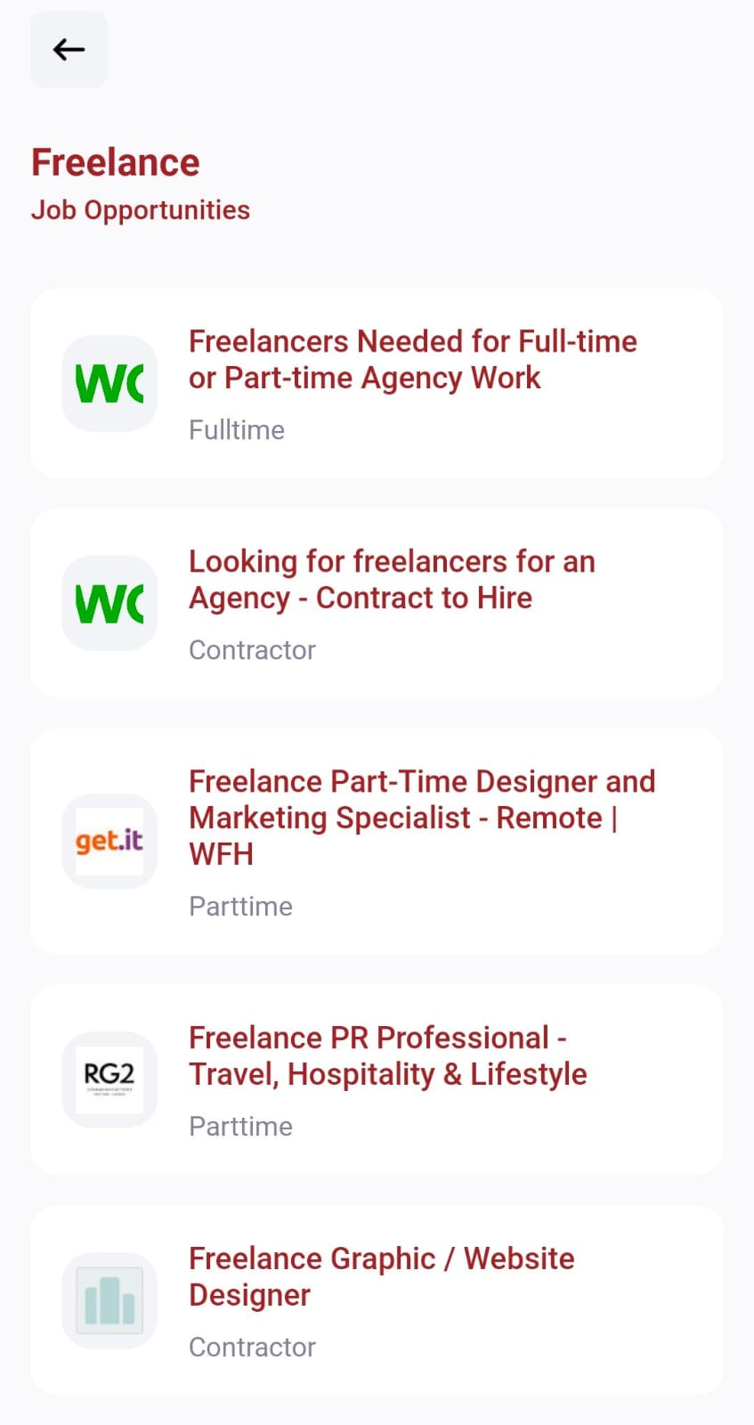

Slide 29
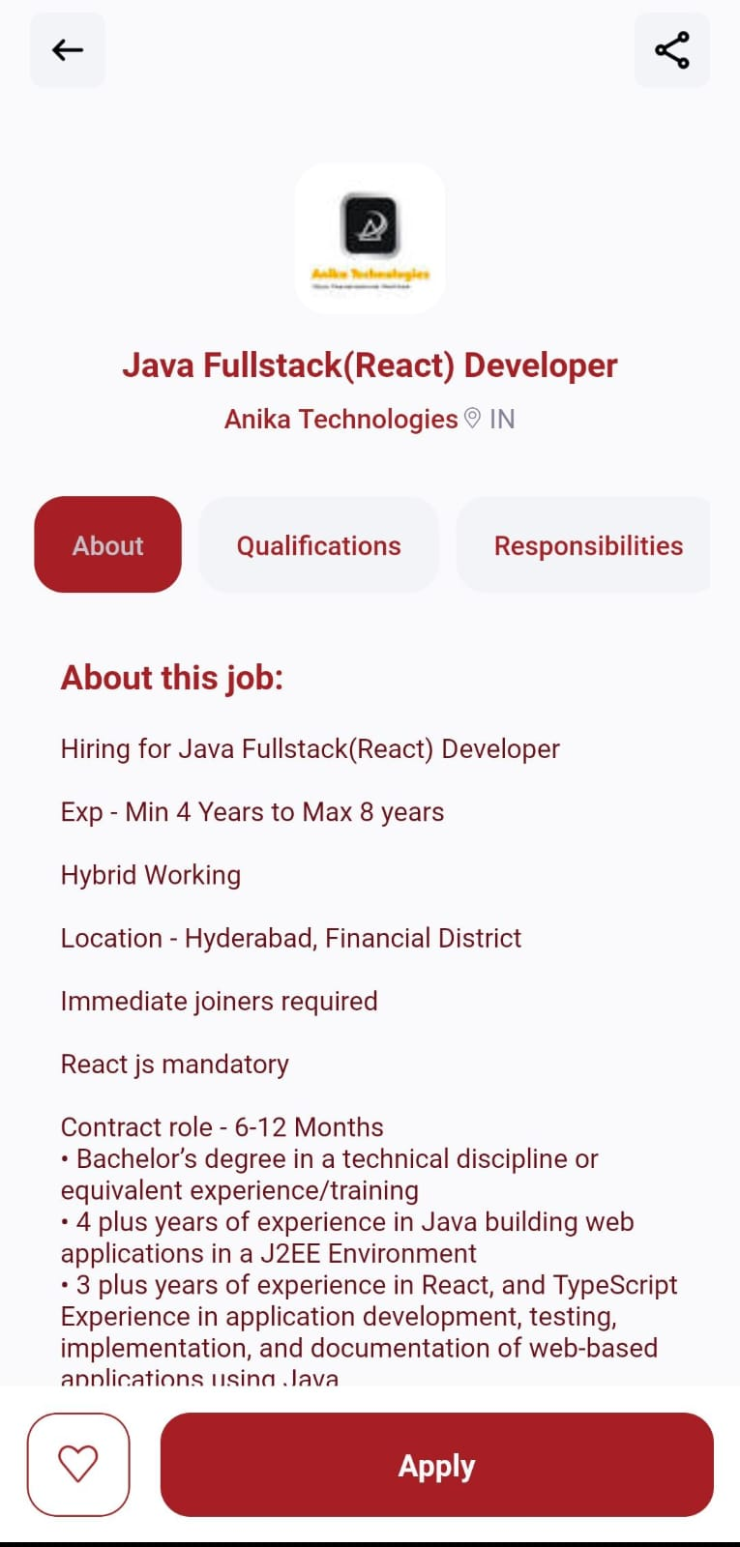
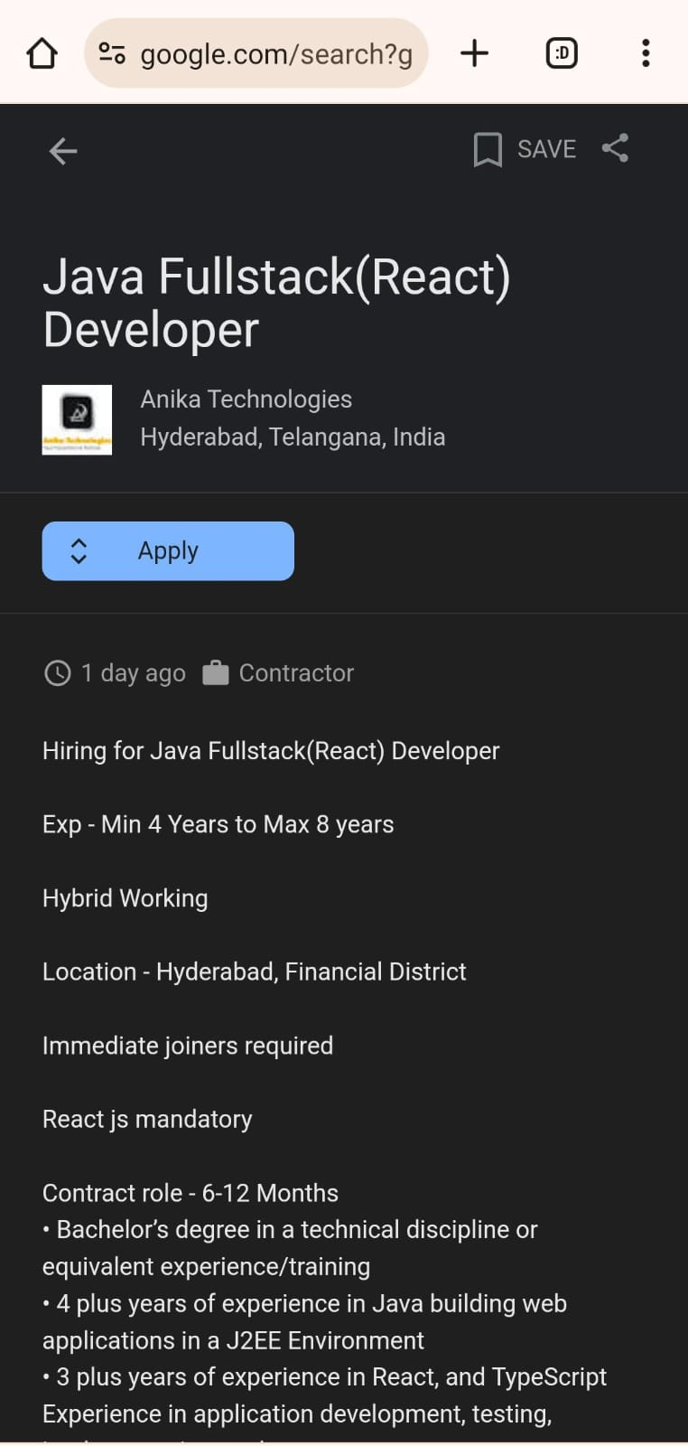

Slide 30
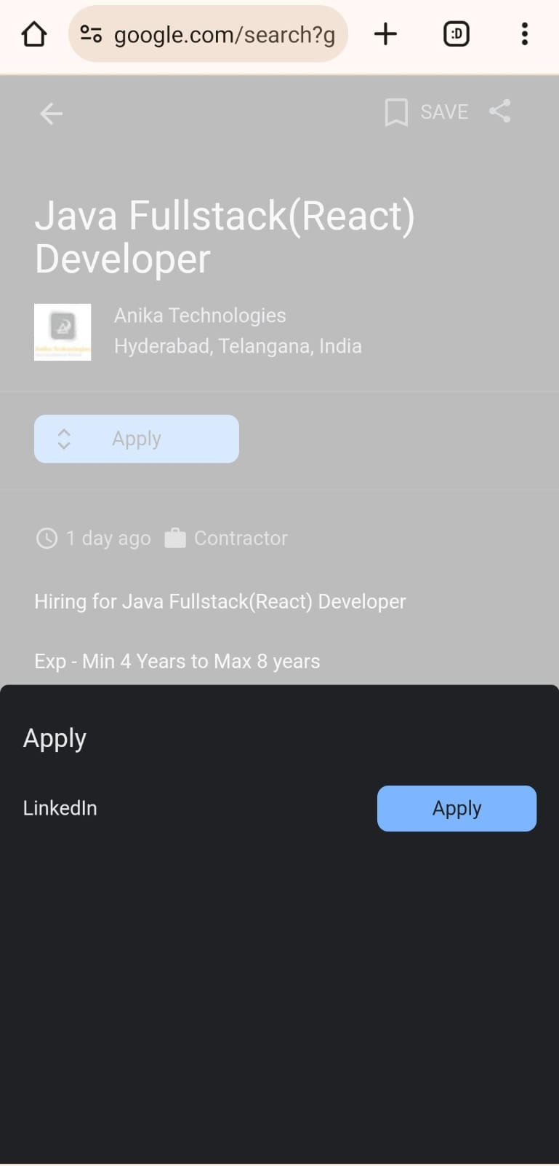
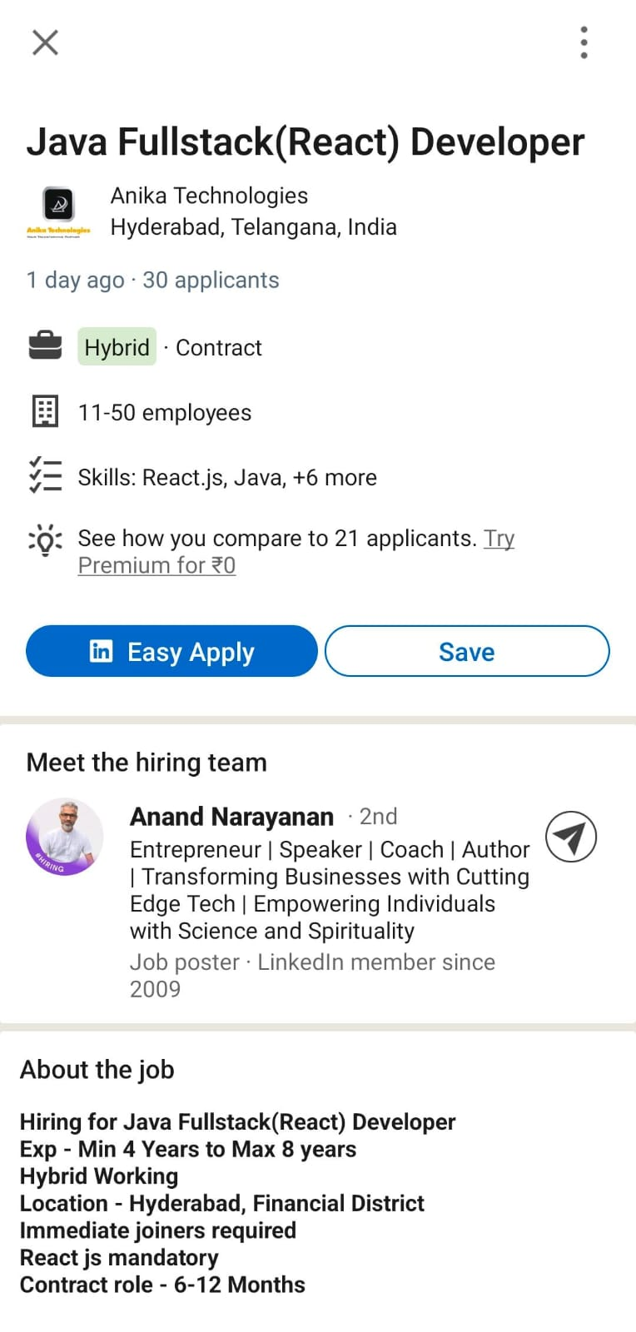

Slide 31


Slide 32
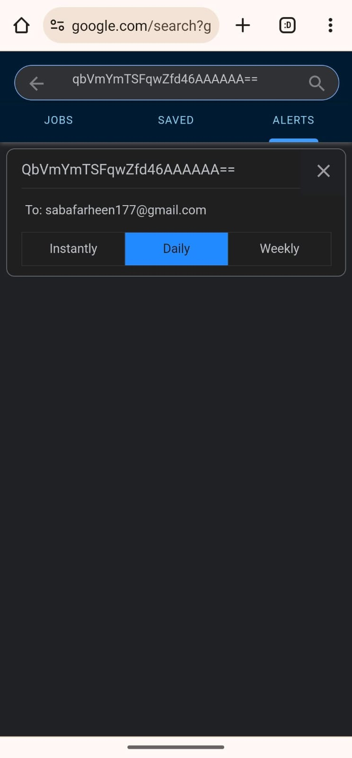
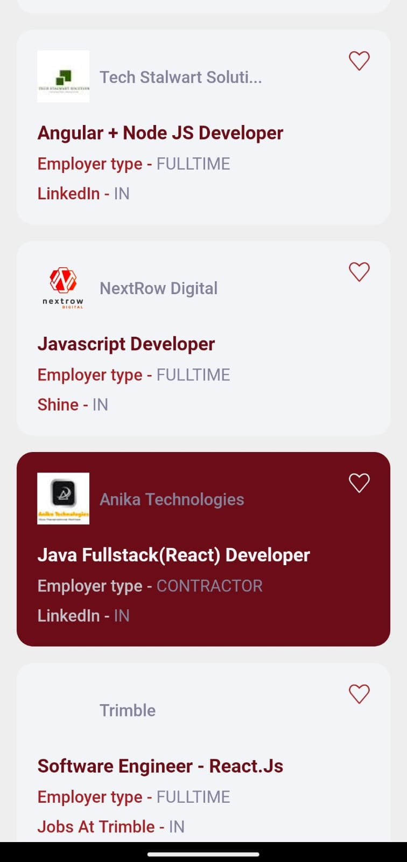

Slide 33

APPLICATIONS
Job search portal is a unique app which igniting careers with desired results.
Improving the recruitment journey through real stories and data. We foster a collaborative workplace that strives to create the best experience for job
Job search portal app for both employer and employee.

Slide 34






Features of android job search portal
Comprehensive Learning Resource Library
Connecting directly to the recruiters
Real-time
Notifications
B2B Model for direct university Engagement
Regularly updated Job Market News
Social Media Integration

Slide 35





Advantages
Accessibility and Convenience
Global Reach
Efficiency and Real-time Updates
Advanced Search Features
User-Friendly Interface and Personalization

Slide 36





Future Enhancement
Manual Feedback with scorecard
AI-powered Interview preparation
Interactive community forums
Video Introductions and Virtual job fairs
Social Networking Features

Slide 37

CONCLUSION
Job search portal is powerful online platforms that aggregate job listings from various sources, providing job seekers with a comprehensive database of opportunities. These engines offer a broad and diverse range of job options covering multiple industries and locations. With real-time updates and advanced search filters, job search engines enable candidates to conduct extensive and efficient job searches, making them valuable tools for those seeking quick access to a vast job market.
37

Slide 38

THANK YOU

Slide 39

Any queries

